Slide 1
– Web Client & Server Programming –
Introduction to JavaScript
CPNT 262
More jQuery & AJAX
Day 6
Introduction to JavaScript

Slide 2
jQuery Get Content
– Web Client & Server Programming –
Introduction to JavaScript
Set Content with:
text() function
  $(“#idName”).text();
html() function - gets markup
$(“#idName”).html();
val() function - gets value from <input>
$(“#idName”).val();
attr()
$(“#idName”).attr(“href”);

Slide 3
jQuery Set Content
– Web Client & Server Programming –
Introduction to JavaScript
Set Content with:
text(“string”) function
  $(“#idName”).text(“some string”);
html(“string”) function - sets markup
$(“#idName”).html(“<em>blah</em>”);
val(“string”) function - sets value from <input>
$(“#idName”).val(“string”);
attr(“attName”, “string”)
$(“#idName”).attr(“href”,”string”);

Slide 4
jQuery CSS Class Manipulation
– Web Client & Server Programming –
Introduction to JavaScript
add/removeClass() functions
$(“h1, h2, p”).addClass(“className”);
$(“#divId”).removeClass(“className”);
toggleClass() function
$(“h1, p”).toggleClass(“className”);
css() function
$(“p”).css({“background-color”: “red”,
“font-size”: “200%”});

Slide 5
AJAX Intro
With AJAX you can:
Update a web page without reloading the page
Request data from the server AFTER the page has loaded
Receive data from the server AFTER the page has loaded
Send data to the server in the BACKGROUND
AJAX – Asynchronous JavaScript and XML
Used by: Google Maps, Gmail, Youtube, Facebook

Slide 6
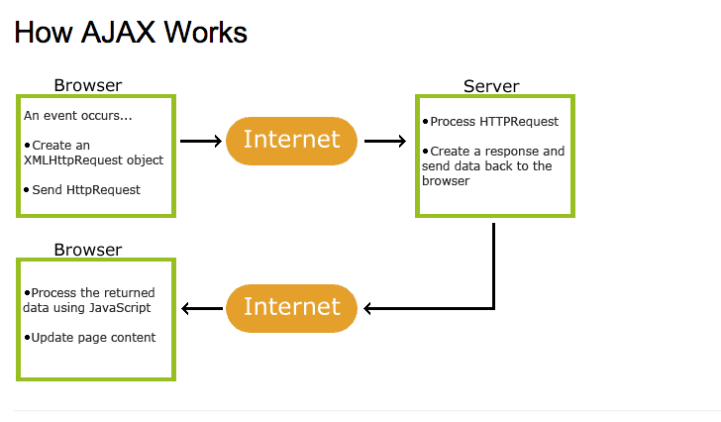
AJAX Intro

Slide 7
AJAX Intro
Create an XMLHttpRequest Object
var xhttp = new XMLHttpRequest();
Create logic to manage the Response
Xhttp.onreadystatechange = function () {
if(xhttp.readyState == 4 && xhttp.status == 200 ){
do something…
}
}
Send a Request to the Server
xhttp.open(“GET”, “ajax_info.txt”, true);
xhttp.send();

Slide 8
AJAX Intro
XMLHttpRequest exposes a ‘readyState’ property with one of the following states:
  0 The object has been created, but the open() method hasn’t been called yet
  1 The open() method has been called, but the request hasn’t been sent
  2 The request has been sent; headers and status are received and available
  3 A response has been received from the server
  4 The request data has been fully received (this is the one we check for in every AJAX request)

